Slide 1
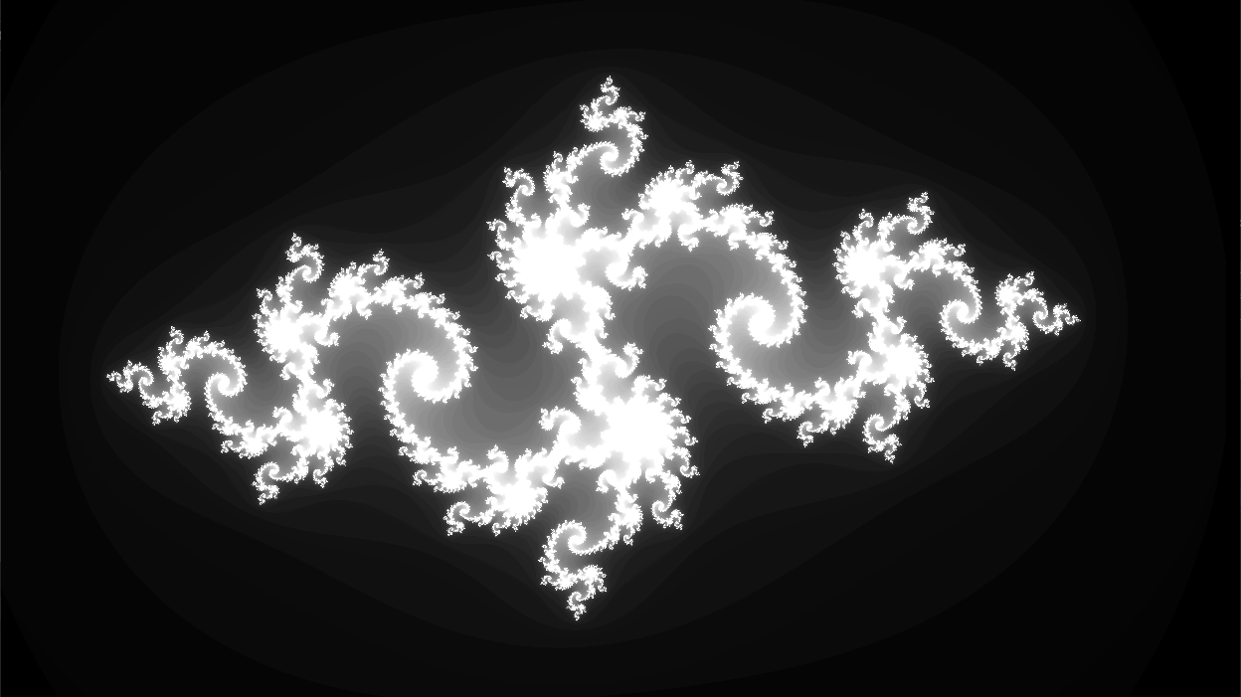
GPGPU
Mandelbrot and Julia Set Renderer with CUDA, SDL, and ImGui
Bertalan Áron

Slide 2
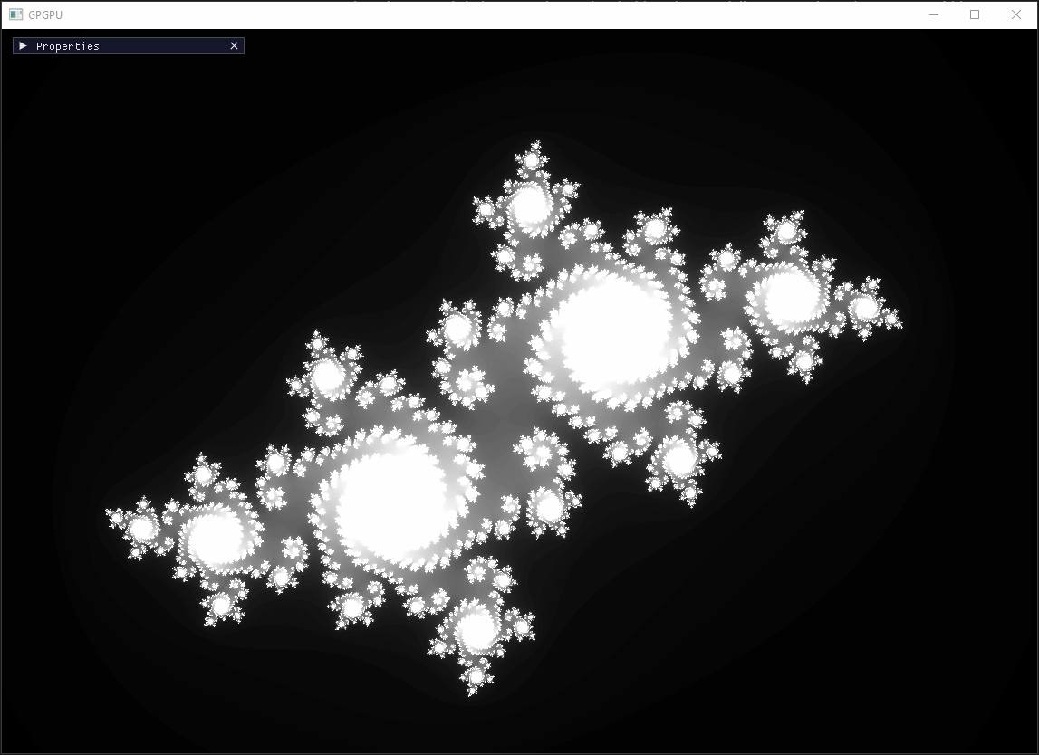
INFINITE ZOOM
Use the mouse wheel to zoom in or out dynamically, focusing on the area pointed to by the cursor. This allows for precise navigation within the fractal space.
Note: Due to the limitations of floating-point precision, extremely deep zoom levels may lead to numerical instability and visual artifacts.

Slide 3
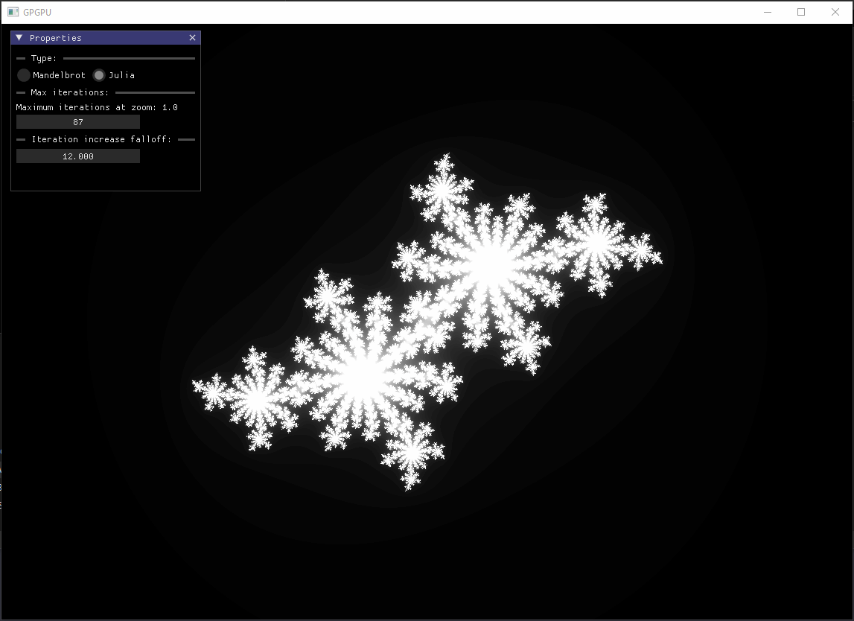
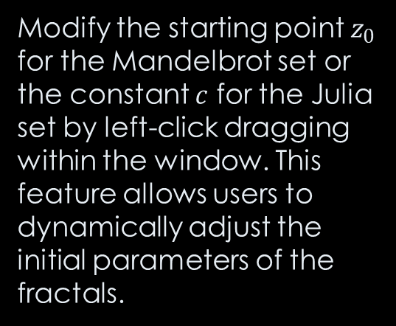
PARAMETER ADJUSTMENT
Modify the starting point $z_{0}$​ for the Mandelbrot set or the constant $c$ for the Julia set by left-click dragging within the window. This feature allows users to dynamically adjust the initial parameters of the fractals.

Slide 4
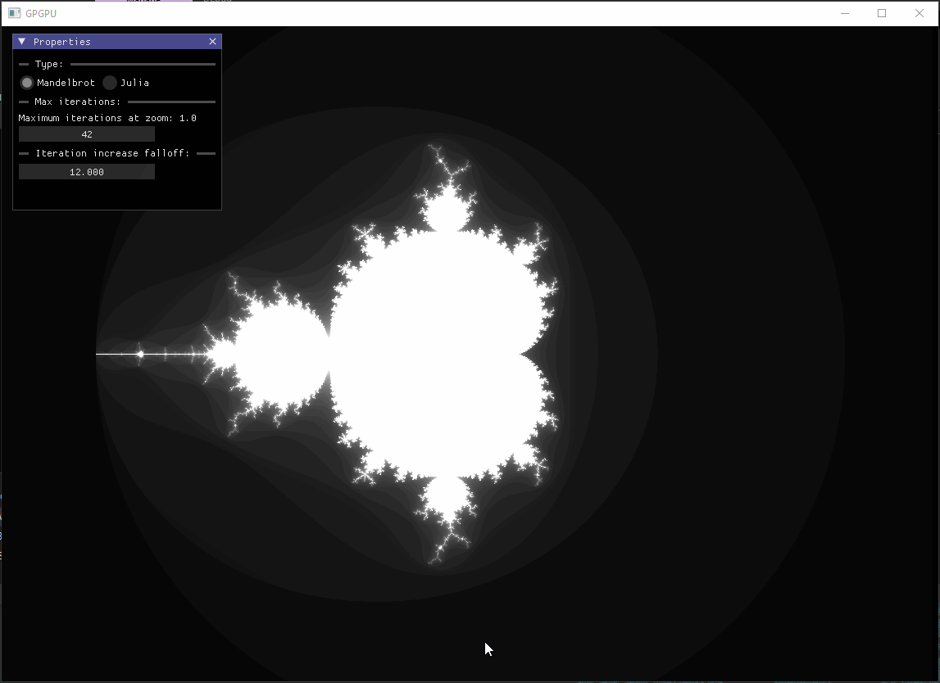
GUI
Utilize the Properties window to control various aspects of the fractal visualization:
Switch between Mandelbrot and Julia sets
Adjust maximum iterations at zoom 1.0:
Control Iteration Count Increase with zoom

Slide 5
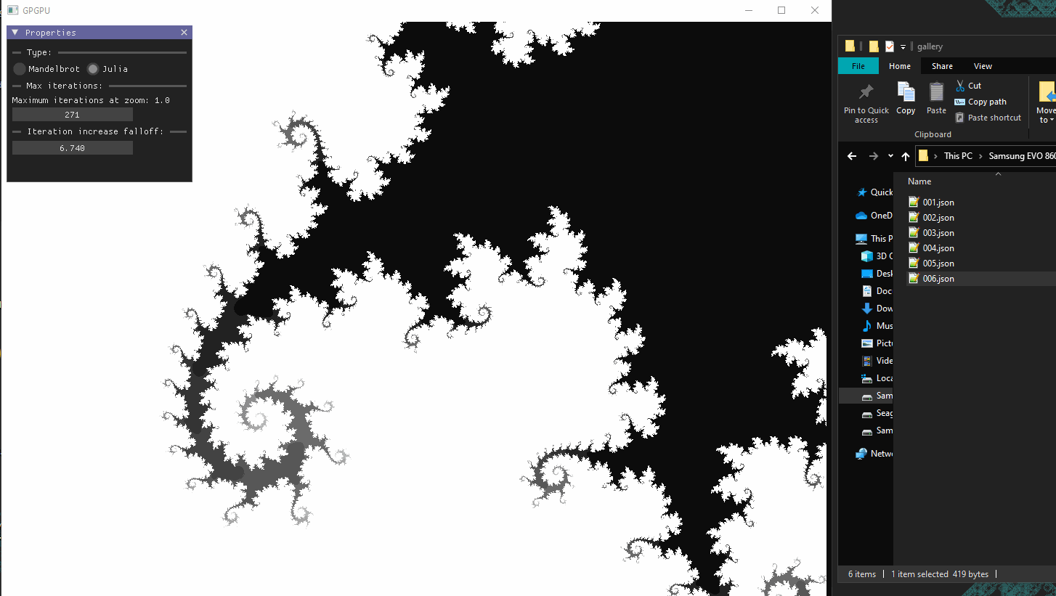
DRAG&DROP
Drag a previously saved options.json file containing fractal parameters onto the application window and the program dynamically loads the data.
This functionality allows users to switch between different configurations, providing a way to compare various fractal landscapes.

Slide 6
State Persistence
Automatically save and load the current position in the fractal space, along with window properties, to a JSON file. This feature allows users to resume exploration exactly where they left off in the previous sessions.

